Slide 1

Why are magnets useful?
“A man who is certain he is right is almost sure to be wrong.”
― Michael Faraday

Slide 2

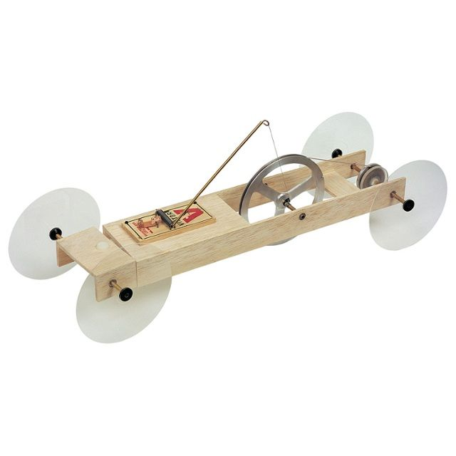
Project description
Source – mousetrap
ECE are developing STEM projects for year 8 to year 10 High School students.
Encourage and Excite students.
Looking for an electrical equivalent of the mousetrap car.

Slide 3
What is a STEM Project?
Science
Technology
Engineering
Mathematics

Slide 4
Project Overview
What
Why
How

Slide 5
Why are magnets useful?
“A man who is certain he is right is almost sure to be wrong.”
― Michael Faraday

Slide 6
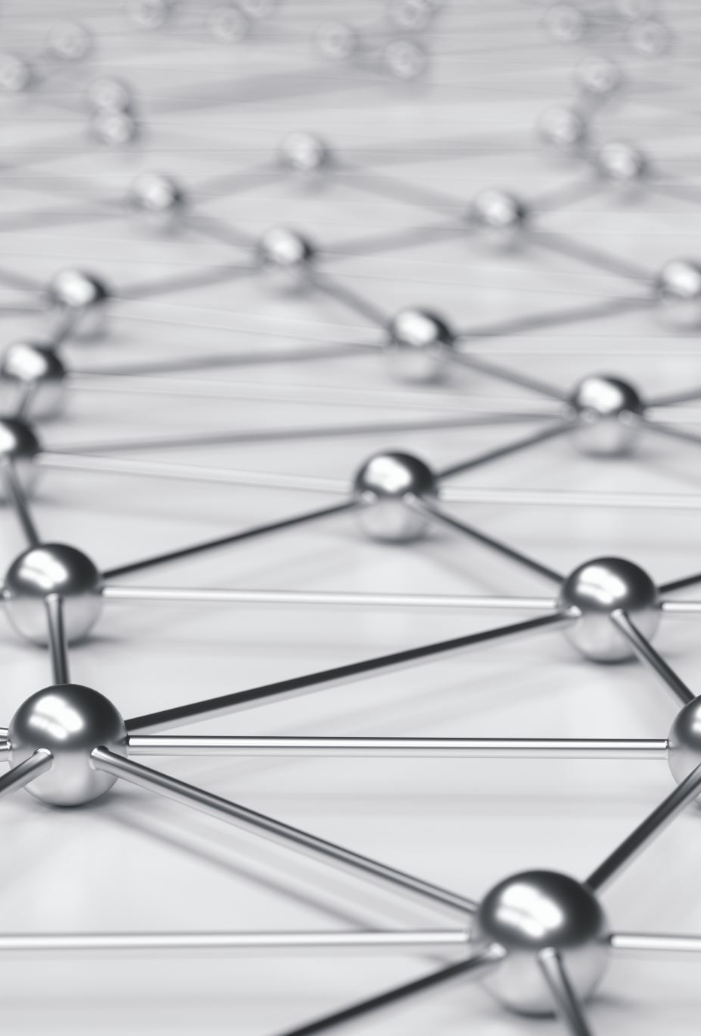
What will they learn?
Principles of Magnetism and Electromagnetism.
What it is and how it works.
Perform experiments with magnets.
How electromagnetic induction works.
How this is used in the real world.

Slide 7

Why should they learn this?
To determine whether Electric current is possible without using a battery?
As, this could reduce the world’s chemical footprint.
Chemical manufacturing plants are dangerous!

Slide 8

Extremely dangerous
Explosion in Chenjiagang industrial park occurred.
March 25th, 2019.
78 Lives lost.

Slide 9
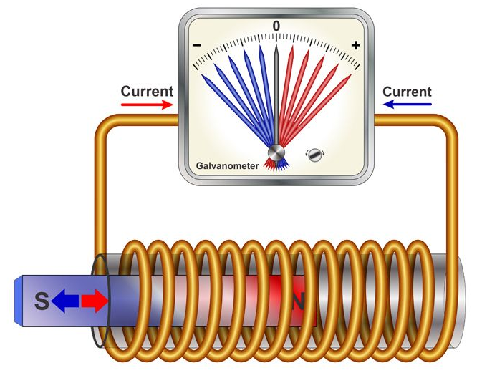
How will they learn this?
They will conduct 3 experiments.
Experiment I – Making a Compass
Main objective is to learn about magnets.
Experiment II – Faraday’s experiment
Main objective is to learn about
electromagnetism.
Experiment III – Faraday’s flashlight
Practical use case.

Slide 10
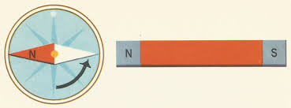
Experiment I – Making a Compass
Finding the north pole of the magnet? (this is useful for the next experiment).
Magnets

Slide 11
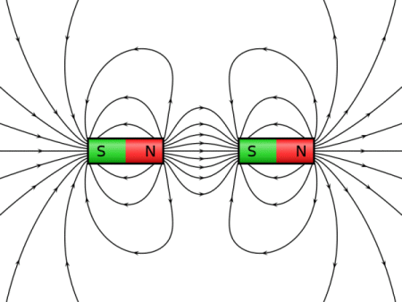
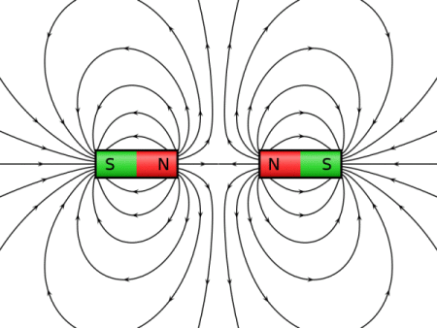
Experiment I – Making a Compass
To identify what a magnetic field is.
Understand what magnetism is.
Like poles repel.
Unlike poles attract.
Magnets

Slide 12
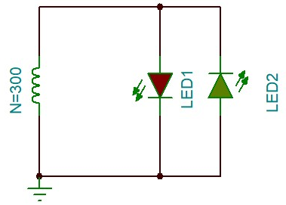
Experiment II - Faraday’s Experiment
Which led will turn on first?
Electromagnetic induction
Notes:
Emf (the voltage generated) = is the rate of change of flux around a coil

Slide 13
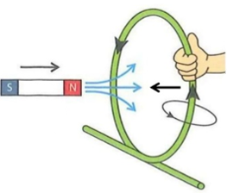
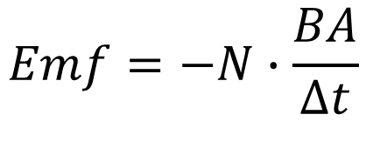
Experiment II - Faraday’s Experiment
Understand why a changing magnetic field induces a current through a coil.
Knowing the pole direction of the magnet, we can use the Right-hand curl rule to find the direction of current flow.
Understand Faraday’s and Lenz’s law.
$$Emf=−N∙\frac{BA}{∆t}$$
Electromagnetic induction
Notes:
Emf (the voltage generated) = is the rate of change of flux around a coil

Slide 14
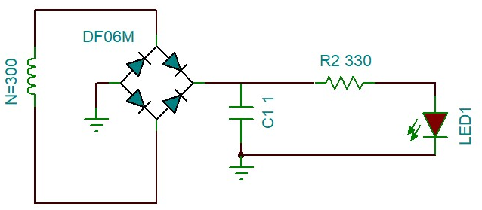
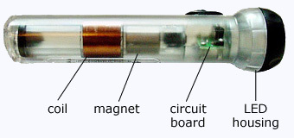
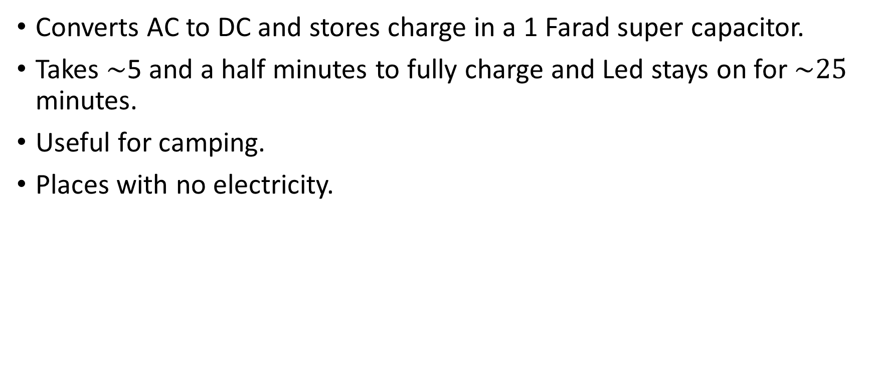
Experiment III - Faraday’s flashlight
Converts AC to DC and stores charge in a 1 Farad super capacitor.
Takes $\sim$5 and a half minutes to fully charge and Led stays on for $\sim 25$ minutes.
Useful for camping.
Places with no electricity.
Practical Scenario
Notes:
Uses same principles as before…

Slide 15
Why are magnets useful?
“A man who is certain he is right is almost sure to be wrong.”
― Michael Faraday

Slide 16
Summary
A moving magnet field induces a current through a coil.
Used a lot in electric motors and generators, etc.
Helps with reducing the world’s chemical footprint

Slide 17
Thanks for listening Any Questions?

Slide 18
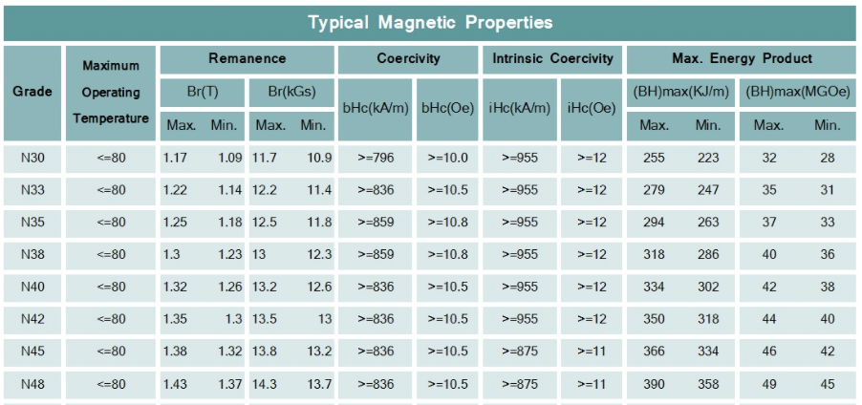
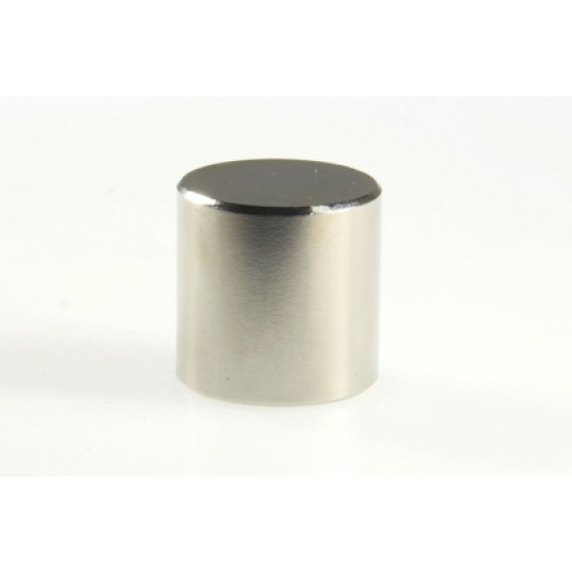
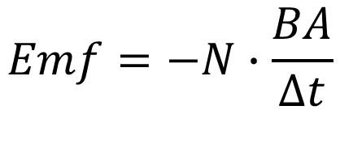
Experiments
$$Emf=−N∙\frac{BA}{∆t}$$
20mm x 25mm
Neodymium Cylinder - magnet
Voltage
Notes:
Emf (the voltage generated) = is the rate of change of flux around a coil

Slide 19
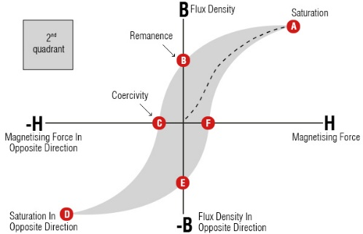
Finding B – magnetic flux

Slide 20
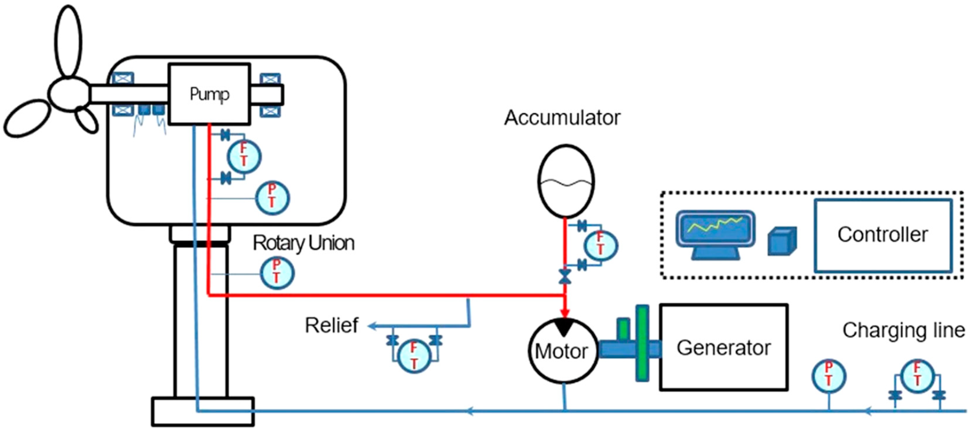

Slide 21
Specifications
Looking for the electrical equivalent of the mouse trap car.
have less than 90 minutes to complete the project.
1 tutor per group.
Spending limit of $500.
No voltages above 20 V (DV or RMS AC).
Easy to change components if needed.
Schematics and drawing’s will be provided as well as a user guide for the tutor.

Slide 22
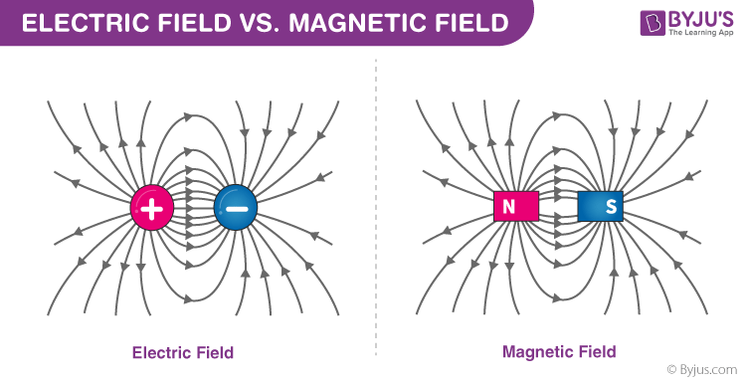
Experiment II - Faraday’s Experiment
To identify what a electric field is and how one can be created.
To know the difference between a electric field and a magnetic field.
To identify what a Electromagnet is.
Electromagnetic induction
Notes:
An electric field is essentially a force field that's created around an electrically charged particle.
Electromagnet = a magnetic field is created when electric current is induced in a wire.

